Slide 1
Opportunistic Planning in Autonomous Underwater Missions

Slide 2
Introduction
Opportunistic planning
Opportunistic planning model
Proposed approach
Experiments and conclusion

Slide 3
Introduction
Replanning
During the execution of a plan, execution activity will diver from the original plan when failures occur and actions to achieve the original goals are replanned from the resulting unexpected state.
Opportunities
opportunities are unlikely, and might arise without warning during execution of a plan.
It is more efficient following the approach presented in this paper, to merge an opportunistic plan into an existing plan, as opposed to replanning for every goal.
Notes:
When large parts of a plan can be expected to execute without incident, it is more efficient to exploit the strategy of replanning on failure.

Slide 4
Opportunistic planning
Conservative planning approach
In this approach, rather than seeking to produce a plan with optimal utility, we seek to produce a robust plan, in which we can have very high confidence that the goals will be achieved within the time and energy budget of the vehicle.
Assumption

Slide 5
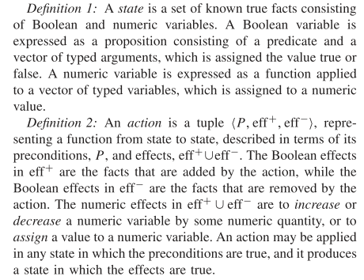
Opportunistic planning model

Slide 6
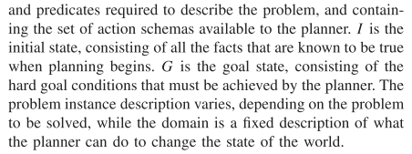

Slide 7
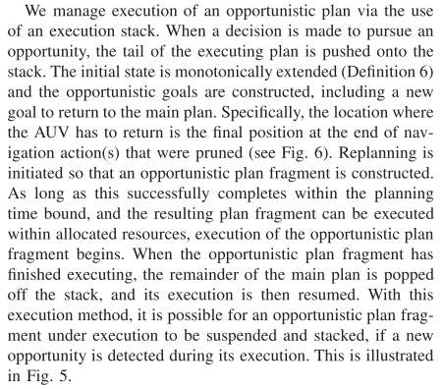
Proposed approach

Slide 8
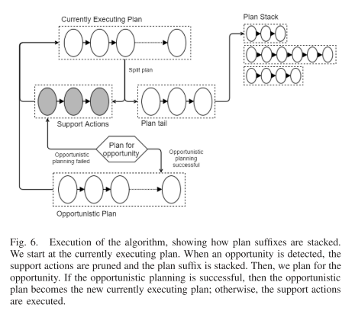

Slide 9
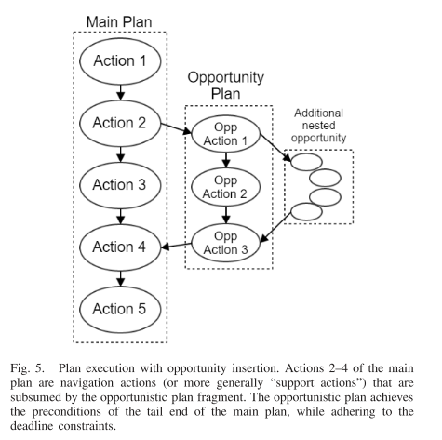

Slide 10
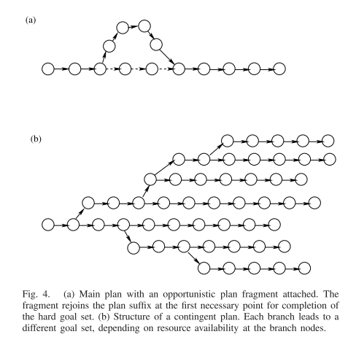

Slide 11
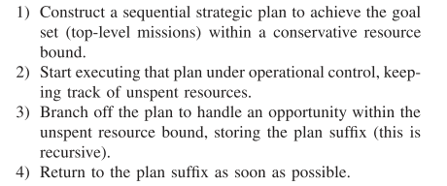
Implementation

Slide 12
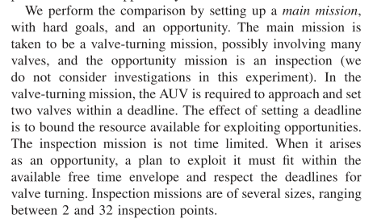
Experiments and conclusion

